Slide 1

Software Engineering
Anno 2019 - 2020

Slide 2


Operation: René

Slide 3



Team
Michele Gargiulo
Camilla Carpinelli
Massimo Picone
Pietro Sabini
Roberto Pecoraro
Gennaro Avossa
Domenico Gennatiempo
Riccardo Marchesano
Antonio Manzolillo
Giuseppe Certini

Slide 4
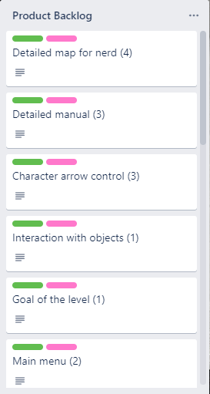
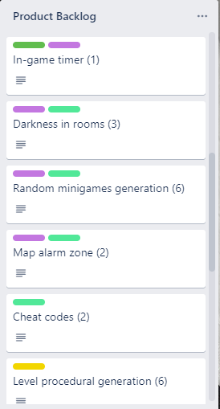
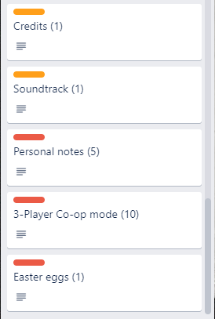
Product Backlog

Slide 5
Definition of Done
- Pass all Unit tests
- Pass all integration tests
- Meet acceptance criteria
- Meet all non-functional requirements
- Product owner must accept the task at the Sprint Review

Slide 6
Estimated velocity (Sprint 1)
The estimated velocity was 15 per Sprint (considering 4 Sprints).

Slide 7
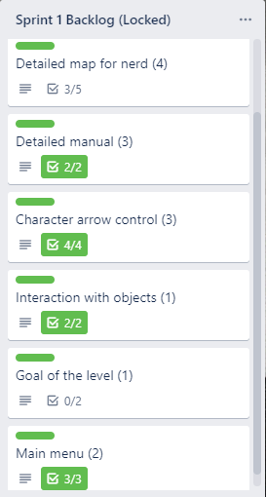
Sprint 1 Backlog
On the side, you can see the stories and tasks completed after the first Sprint.
The Story Points for each task are indicated in brackets.

Slide 8
Sprint 1 Review
During the Sprint Review, the P.O. tried a demo of the game: it featured a small level with one room, one minigame and a robber being able to move within it.
The P.O. proposed to:
Add a Colorblind Mode
Create a goal for the level
Provide a detailed map for the manual
as the next tasks.

Slide 9
Sprint 1 retrospective
MORE
LESS
Communication among the components of the group
Concentration on the
graphical aspects
KEEP
START
The grit and enjoyment showed by everyone
to face this challenge
Expanding the game with
new minigames and map alarms
Most of the time spent during the Sprint was due to the decision of the graphic library to use for the project, in fact the team made various Spikes with different libraries to verify which one would be more useful.
In the end, the team decided for Slick2D.
STOP
Creating spikes with new libraries.
We’ll go with Slick2D

Slide 10
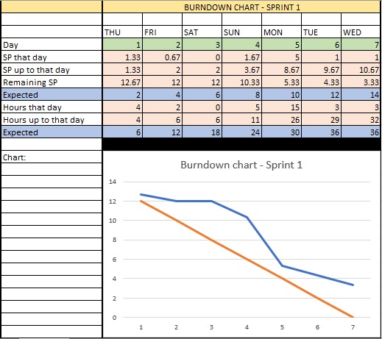
Burndown Chart: Sprint 1
We arrived at the end of the Sprint with about 11 Story Points done on 14 expected.

Slide 11
Actual velocity (Sprint 1)
ALMOST DONE
DONE
DONE
The actual velocity was 9.
DONE
NOT STARTED
DONE

Slide 12
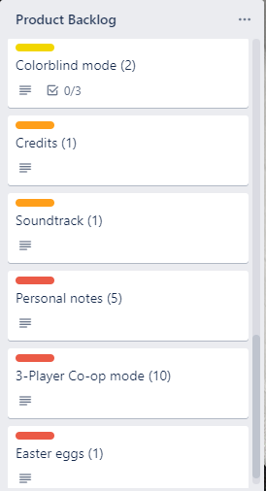
Product Backlog

Slide 13
Estimated velocity (Sprint 2)
The estimated velocity for Sprint 2 was 15.
The mean between the initial estimated velocity and the actual one would be 12, but we thought we could compensate for the time spent deciding the library.

Slide 14
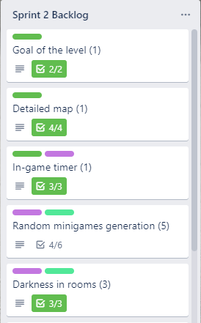
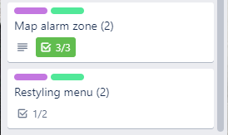
Sprint 2 Backlog
On the side, you can see the stories and tasks completed after the second Sprint.

Slide 15
Sprint 2 Review
During the Sprint Review, the P.O. was satisfacted with the work done. He said that a mode in which a level is randomly generated would be very entertaining, (apart from the main Campaign mode), and would greatly improve the game replayability.
The idea was well received by the team, that decided to begin working on this matter.

Slide 16
Sprint 2 retrospective
MORE
LESS
Pair programming
Concentration on other modes than the main ‘2-players’
KEEP
START
Working on minigames generation
Implementing procedural generation
During the retrospective, no story has been added: the team decided to continue to work on the same tasks, which will fulfill the requirements imposed by the P.O.
STOP
Spending effort in improving the main menu

Slide 17
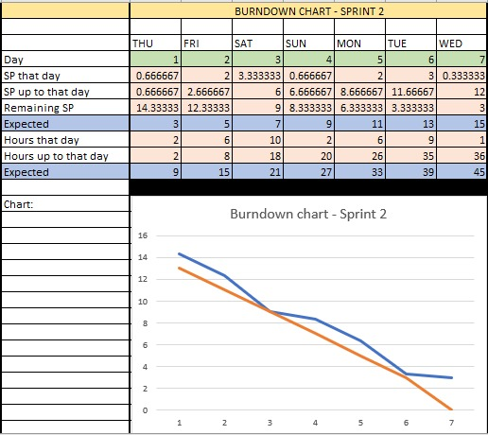
Burndown Chart: Sprint 2
We arrived at the end of the Sprint with 12 Story Points done on 15 expected.

Slide 18
Actual velocity (Sprint 2)
DONE
DONE
DONE
The actual velocity was 8.
ALMOST DONE
DONE
DONE
ALMOST DONE

Slide 19
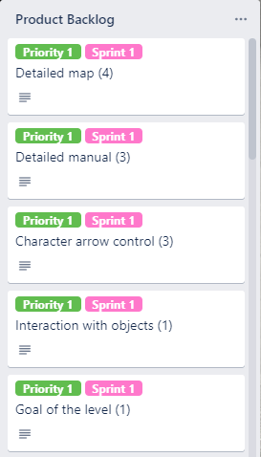
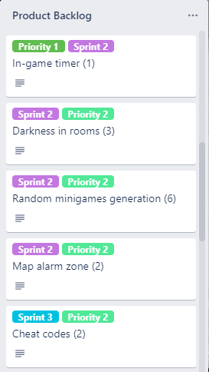
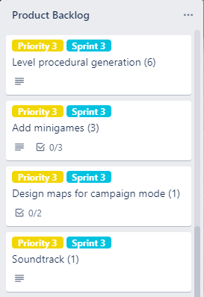
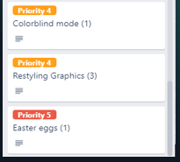

Product Backlog

Slide 20
Estimated velocity (Sprint 3)
The estimated velocity for Sprint 3 was 12.

Slide 21
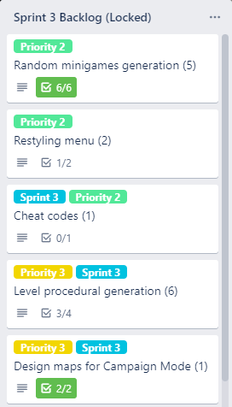

Sprint 3 Backlog
On the side, you can see the stories and tasks completed after the third Sprint.
The Story Points for each task are indicated in brackets.

Slide 22
Game Modes
The main twist implemented during this Sprint is the possibility to select different Game Modes.

Slide 23
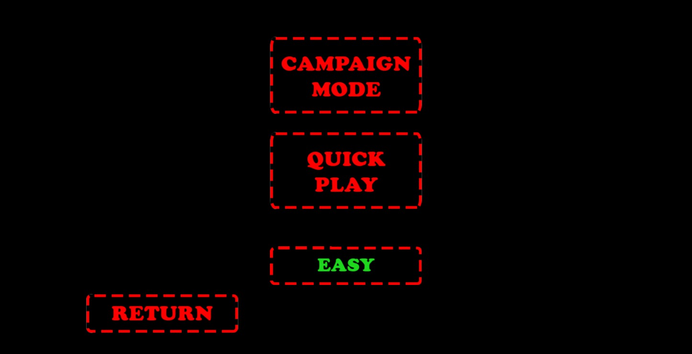
Game Modes (cont.)
Now, when you select ‘Play’ in the main menu, you can select between ‘Campaign Mode’ and ‘Quick Play’.

Slide 24
Sprint 3 Review
The P.O. tried the demo of the game and appreciated the improvements made to the main menu: he found it more fluid and understandable, and particularly enjoyed the possibility of the difficulty selection. He finally incited the team to finish the Quick Play mode, so he raised its priority, thus this story has been scheduled with a high priority for the following Sprint.

Slide 25
Sprint 3 retrospective
MORE
LESS
Tests after changes to the code
Effort in decorating the maps
and making them too big and dispersive
KEEP
START
The team decided to delete the ‘Three-player Mode’ story, because networking was involved and that would have signified a huge time problem.
‘Single-player Mode’ was also deleted, because the team realized it wouldn’t have been particularly entertaining, deviating to much from the original idea.
Implementing procedural generation
Doing the small-priority stories
STOP
‘3-player’ and ‘single-player’ modes stories

Slide 26
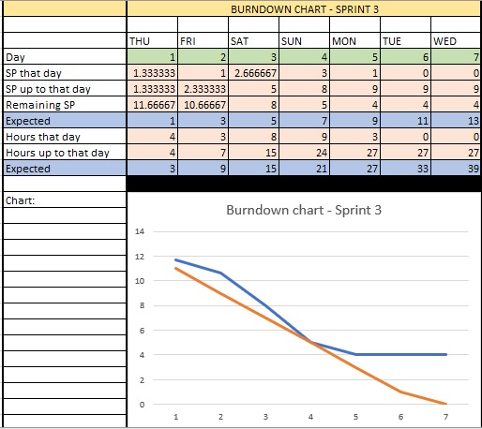
Burndown Chart: Sprint 3
We arrived at the end of the Sprint with about 9 Story Points done on 13 expected (we had 4/6 already done in ‘Random minigame generation’ and 1/2 in ‘Restyling menu’).

Slide 27
Actual velocity (Sprint 3)
DONE
ALMOST DONE
NOT STARTED
The actual velocity was 9.
The team completed ‘Random minigame generation’ from Sprint 2 and almost completed the new Sprint 3 stories.
ALMOST DONE
DONE
DONE

Slide 28
Product Backlog

Slide 29
Estimated velocity (Sprint 4)
The estimated velocity for Sprint 4 was 11.

Slide 30
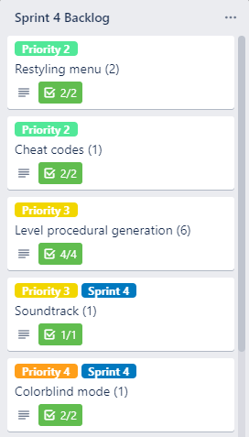
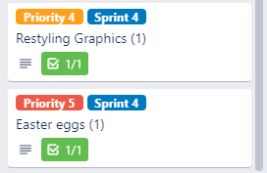
Sprint 4 Backlog
On the side, you can see the stories and tasks completed after the fourth Sprint.
The Story Points for each task are indicated in brackets.

Slide 31
Procedural Generation
Now it’s possible to select the ‘Quick Play’ Mode, implemented with the Procedural Generation.
The twist of this mode is that the level is randomly generated, making sure that it is completable and doesn’t incur in ‘deadlocks’ (e.g. a key spawns in the same room that it opens).

Slide 32
Sprint 4 Review
The P.O. tested the game: now the Procedural Generation works, and a random map is generated with a central corridor and various rooms attached to it. The Map Alarms have also been implemented, and now the challenge offered is even more.
The P.O. finally said that he’d like too see more of this game in the future, with a larger Campaign mode and the development of a proper plot for the Campaign.

Slide 33
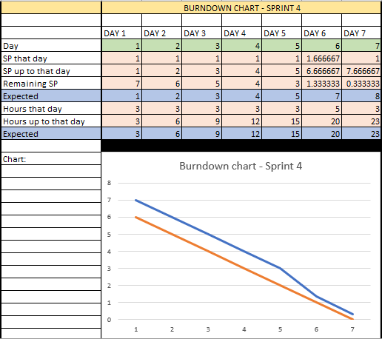
Burndown Chart: Sprint 4
We arrived at the end of the Sprint with 8 Story Points done on 8 expected (we had 4/6 already done in ‘Level procedural generation’ and 1/2 in ‘Restyling menu’), thus completing the project.

Slide 34
Actual velocity (Sprint 4)
DONE
DONE
DONE
DONE
The actual velocity was 8.
This is obvious, because the remaining story points were less than the estimated velocity.
The team completed ‘Restyling menu’ and ‘Lev. proc. gen.’ from Sprint 3.
DONE
DONE
DONE

Slide 35
Testing – Unit Test
The Unit Test was made using JUnit, on all the classes and methods that contemplated a deterministic result, since many parts of the software relied on random number generation.
Tests made = 53

Slide 36
Testing – Integration Test
The Integration tests were made so that the testers were other team members than the ones that wrote the code. In particular, these tests were made on all the minigames, the Campaign mode, the Map Alarms and the procedural generation.

Slide 37
Testing – System Test
A final test with all the components merged was made.
The team tried firstly all three levels of the Campaign mode and tested its feasibility.
Then it tested the Quick Play mode various times, with different randomly generated rooms.
The test was successful.

Slide 38
Testing – Acceptance Test
The P.O. tested the game to see if it met all the acceptance criteria of project stakeholders.
The response was positive.

Slide 39
Agile practices adopted
User stories
Increments
Sprint Planning meeting
Daily Scrum
Sprint Review
Sprint Retrospective
Requirement prioritization
Pair programming
Refactoring
Iterative Development

Slide 40
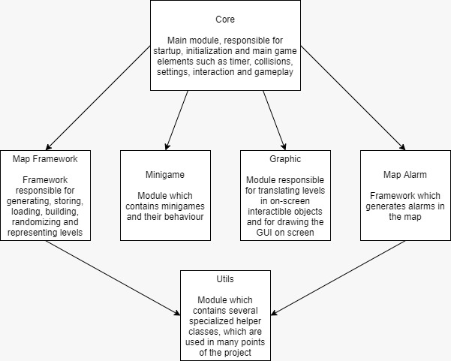
System architecture

Slide 41
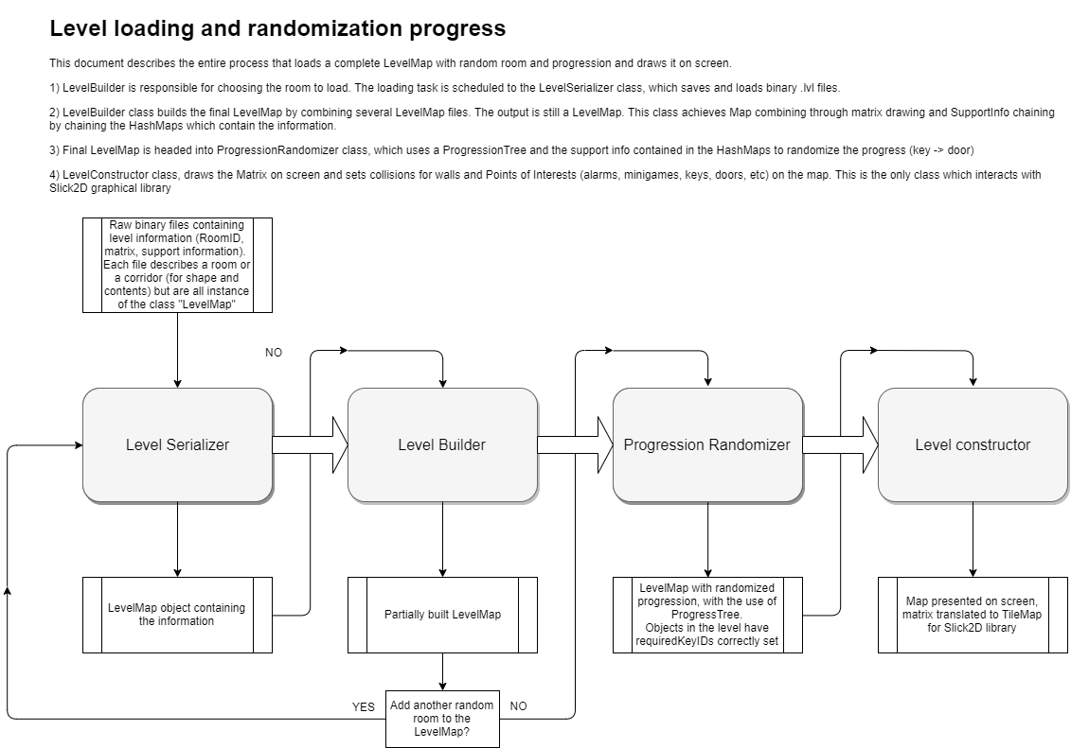
System architecture

